Slide 1

WEB SOCIAL MEDIA ANALYTICS & VISUALIZATION
CMP7202
Dinesh Thapa - 23206188
MSc. Big Data Analytics
FACULTY OF COMPUTING ENGINEERING AND THE BUILT ENVIRONMENT

Slide 2

Twitter US Trends Analytics (Covid19)

Slide 3
Data Preprocessing
Load Data into DataFrame
Select tweets only from US Locations
Filter Hashtag #covid19
Remove row having empty text or hashtags
Remove columns which we do not need for analysis
Identify Data inconsistency (date formats, text encoding etc.)
Handling Typos and Formatting Issues (Converting to lowercase, remove special characters etc.)
Saving final data into new DataFrame

Slide 4
Key Questions for Analysis:
What are the most common discussion topics identified from the tweets using the #covid19 hashtag?
What are the most frequent words that appear in the word cloud generated from the tweets analyzed using the LDA algorithm?
What percentage of tweets with the #covid19 hashtag are categorized as neutral, positive, and negative based on sentiment analysis?
Which regions or cities in the US show the highest density of discussions related to #covid19 based on geospatial analysis of tweet locations?
What is the trend in the frequency of tweets with the #covid19 hashtag over the periods?
What are the top 3 devices used by users in the US to post tweets with the #covid19 hashtag?

Slide 5
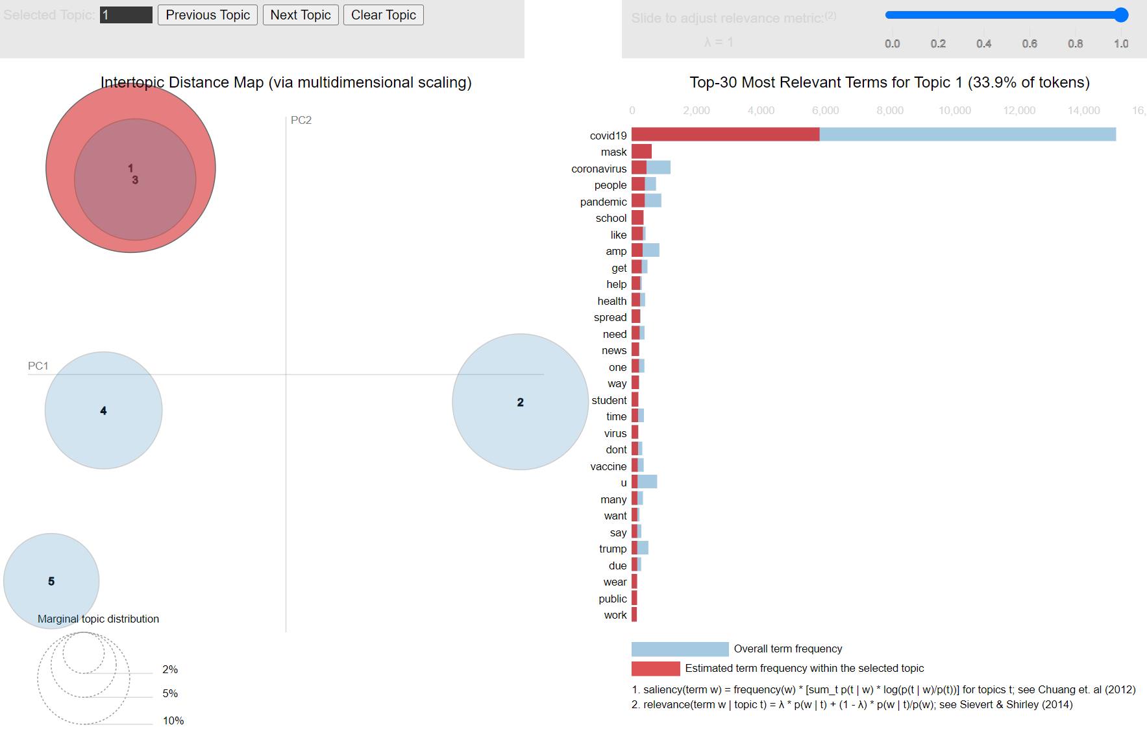
Topic Modeling – Most common discussion topics in tweets using hashtag #covid19
Note:
People are talking a lot about COVID-19, masks, pandemics, schools, health, students, and vaccines in their tweets.

Slide 6
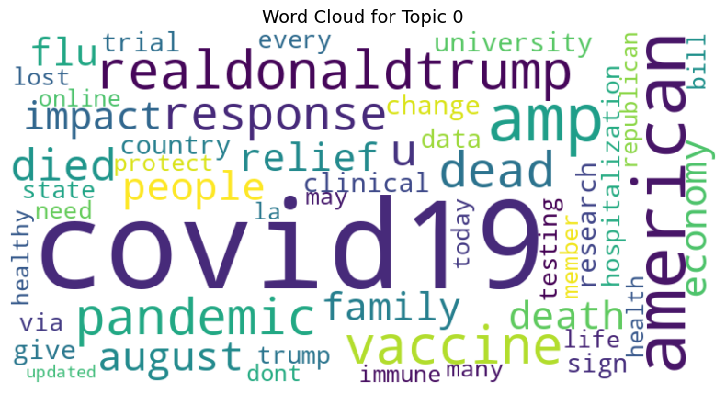
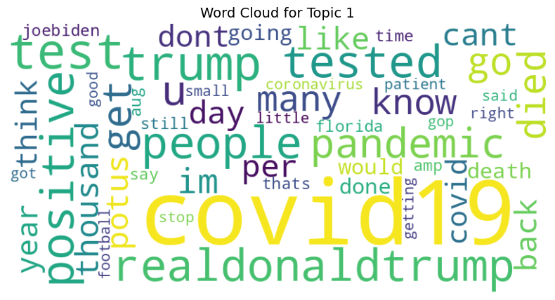
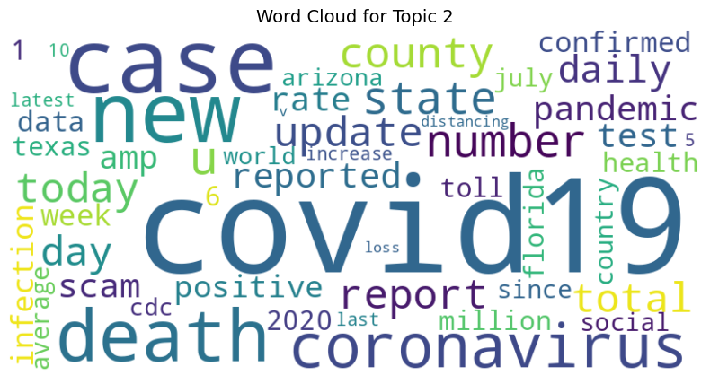
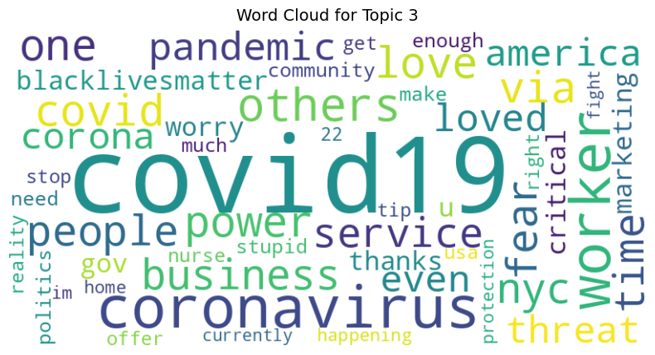
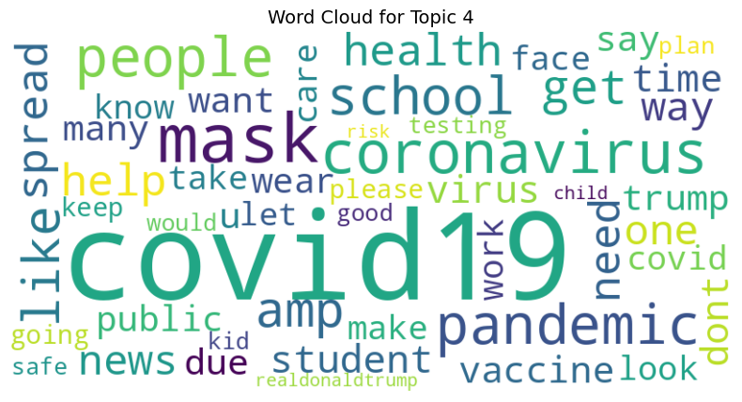
Word Cloud – Visualization of Most Common Words based on Topic Modeling (LDA) algorithm
Note:
The words used most often in tweets show what people are mainly talking about.

Slide 7
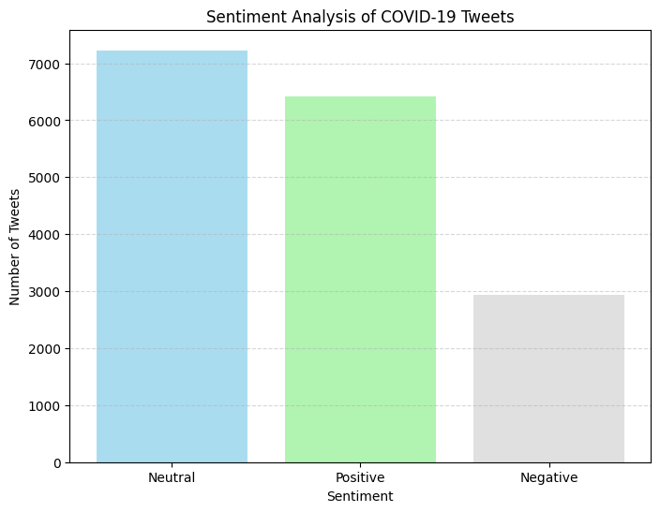
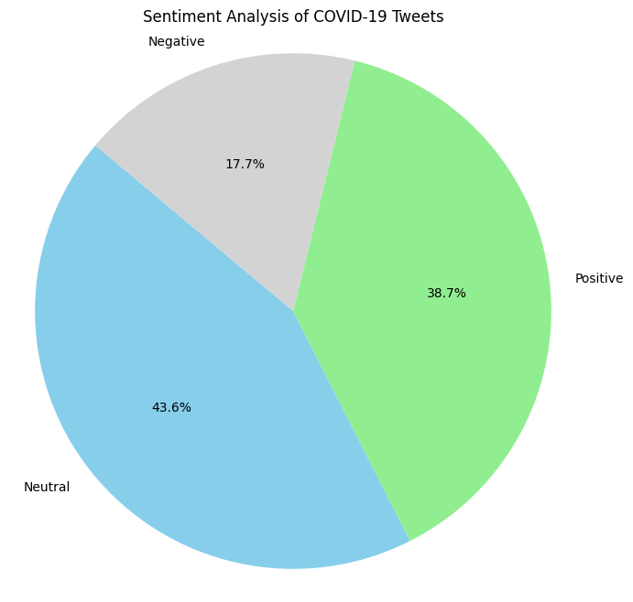
Sentiment Analysis – Neutral, Positive and Negative
38.7% Positive: A significant portion of tweets show a positive sentiment, suggesting optimism, support, or positive perspectives on COVID-19 topics.
17.7% Negative: Some tweets convey a negative sentiment, indicating concerns, frustrations, or criticisms related to COVID-19.
43.6% Neutral: Many tweets express a neutral sentiment, meaning they are neither positive nor negative.

Slide 8
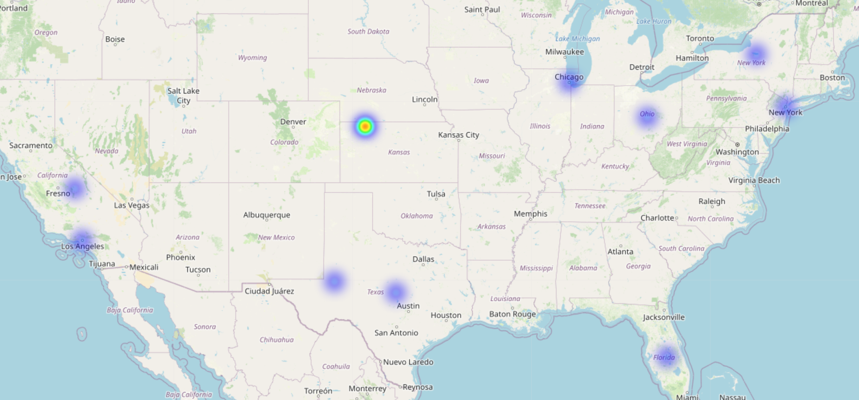
Geospatial Analysis – Where Most Discussions are taking place in the US with #covid19
This analysis shows where tweets about COVID-19 are coming from and identifies the busiest areas for discussions about the coronavirus across the country.

Slide 9
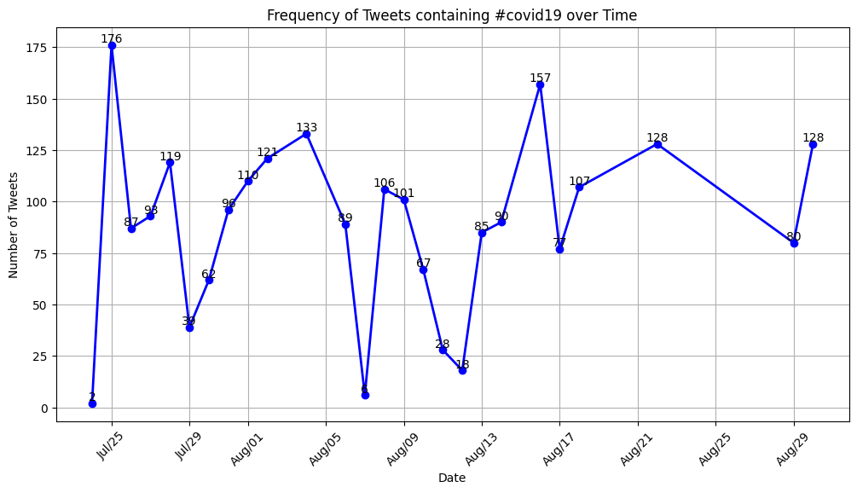
Trends Over Time: Frequency of Tweets
Significant spike in tweet activity.
Another notable peak in tweet volume.
This line graph shows how often tweets containing the hashtag #covid19 have been posted over time in the United States.
Sharp drop in tweet volume.

Slide 10
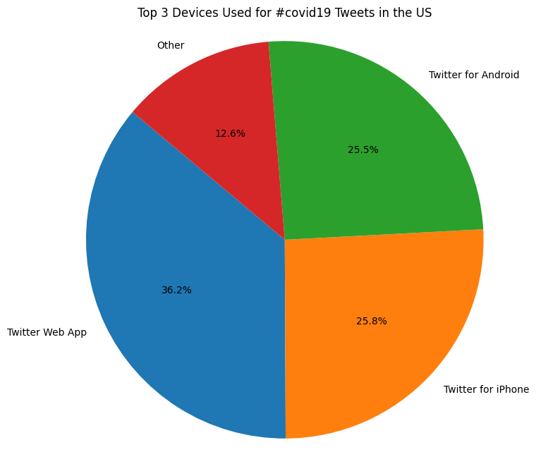
Top 3 Devices Used for #covid19 post in the US
Twitter for Web App: 36.2%
Twitter for Android: 25.5%
Twitter for iPhone: 25.8%
Other: 12.6%
This information provides insights into the variety of devices or platforms used by users to engage in discussions related to COVID-19 on Twitter in the US.

Slide 11

Facebook Graph Network Analysis (Social circles)

Slide 12
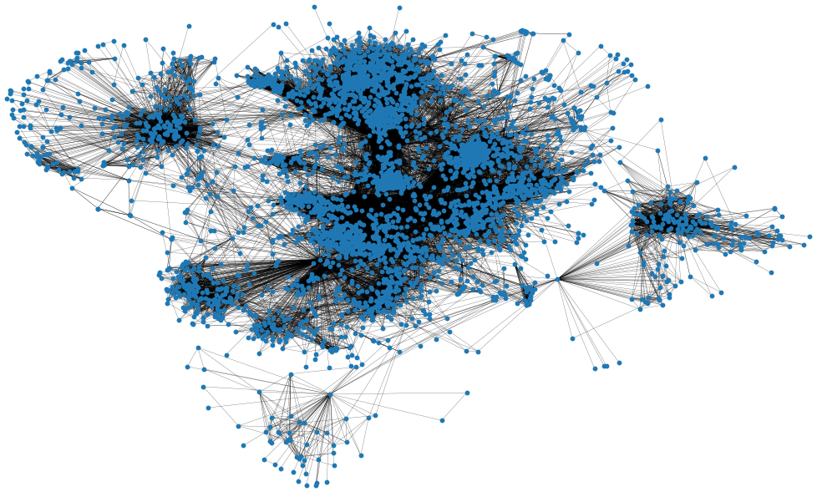
Graph Visualization
Statistics:
Number of Nodes: 4039
Number of Edges: 88234
Average degree of a node: 43.6910

Slide 13
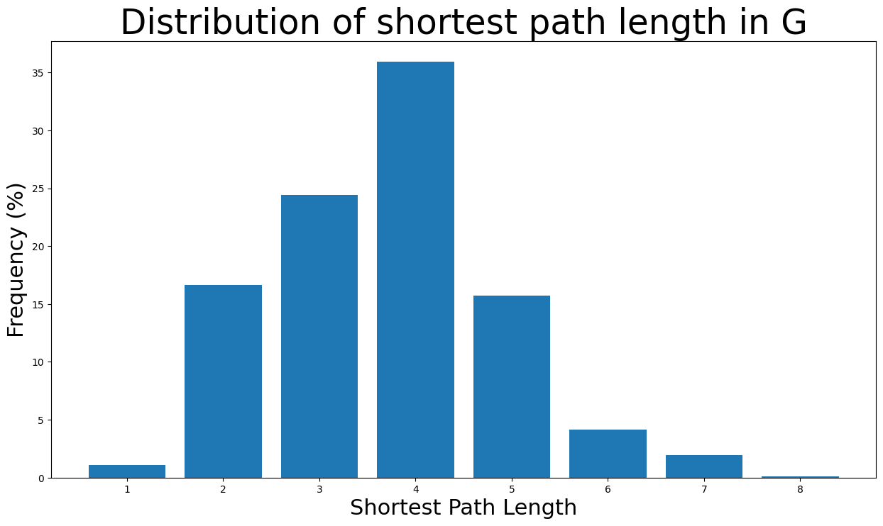
Distribution of shortest path length in G
Based on their frequency of occurrence as a percentage of the total valid path lengths.

Slide 14
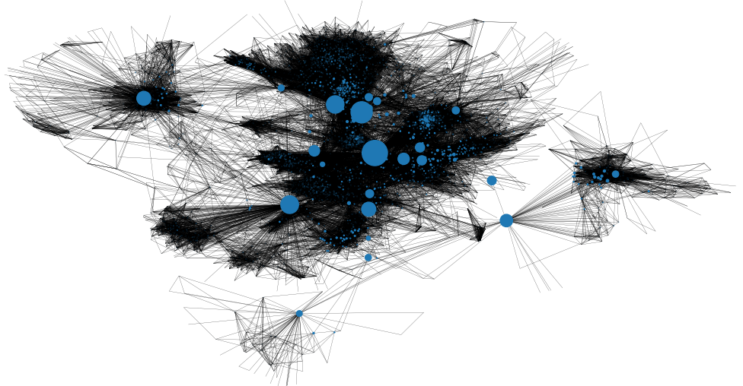
Users with the highest degree centrality
Connectors between different parts of the network.

Slide 15
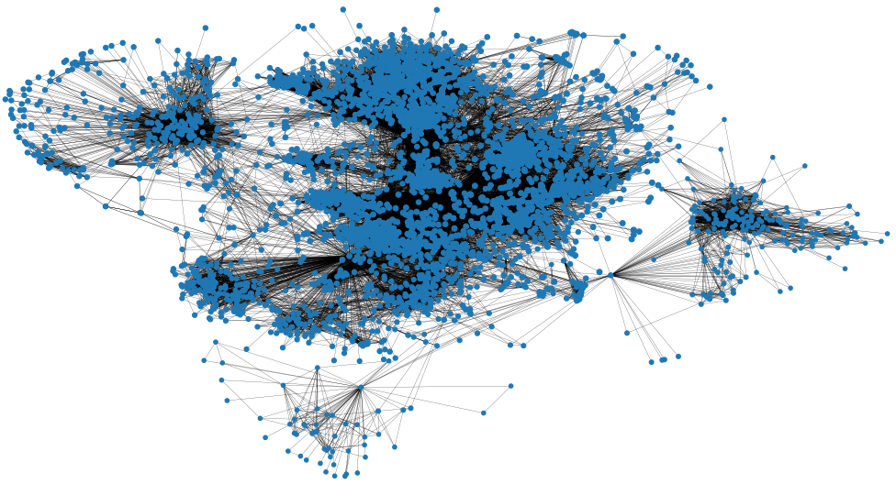
The closeness centralities are distributed
How quickly or easily a node can reach all other nodes in the network.

Slide 16
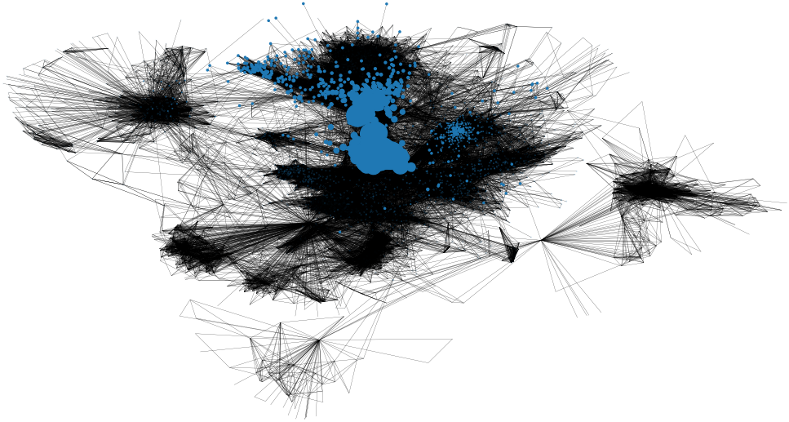
The closeness centralities are distributed
How important each node is in the network based on its connections to other important nodes. quickly or easily a node can reach all other nodes in the network.
Nodes with higher eigenvector centralities are connected to other well-connected nodes, making them more influential.

Slide 17
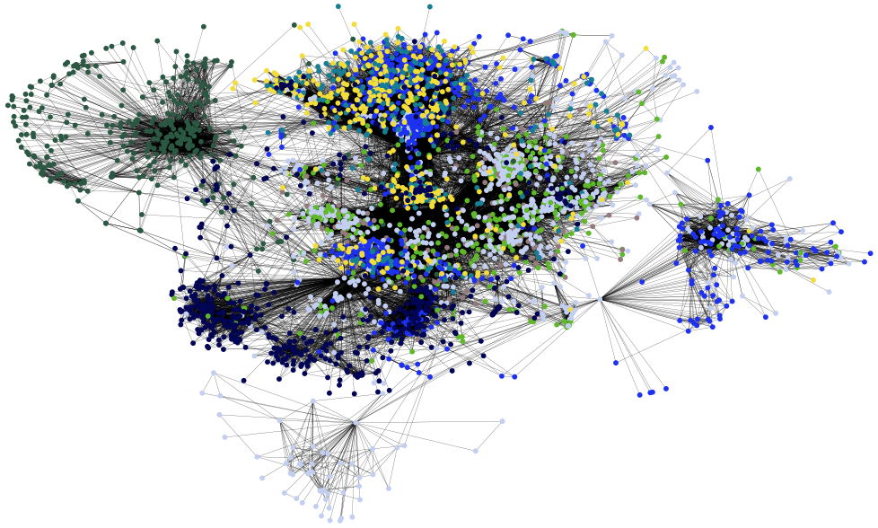
Community Detection: Semi-synchronous label propagation method
In details, 44 communities were detected.
Communities have been identified and visualized in the graph.
Each community is shown in a distinct color, and the nodes within each community are positioned near one another.

Slide 18
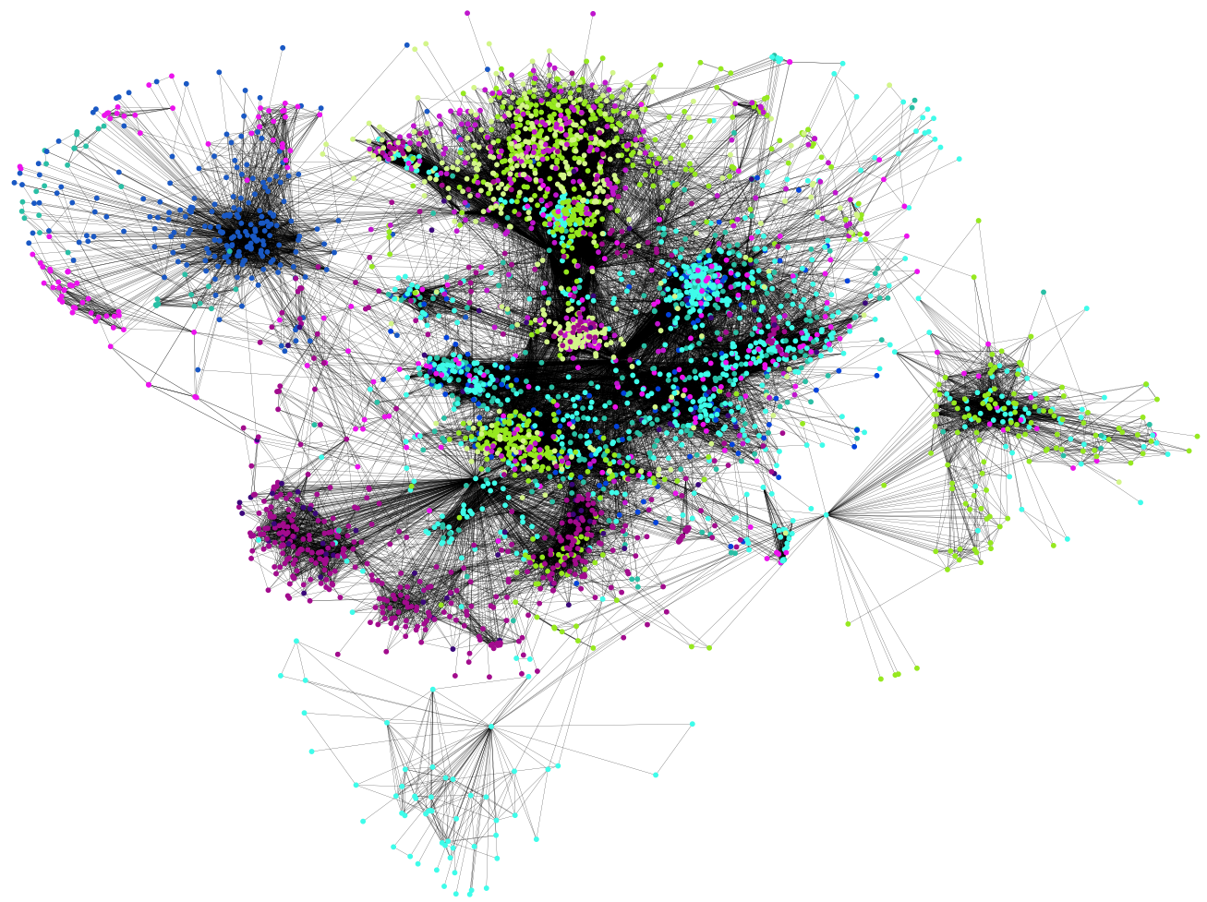
Community Detection: Asynchronous fluid communities algorithm
This function helps us choose how many communities to find.
For example, if we want to find 10 communities, we can specify that number.

Slide 19
Thanks!
Source Code
https://github.com/DineshThapaX/web-social-media-analytics-twitter-facebook
Any questions?

